Slide 1
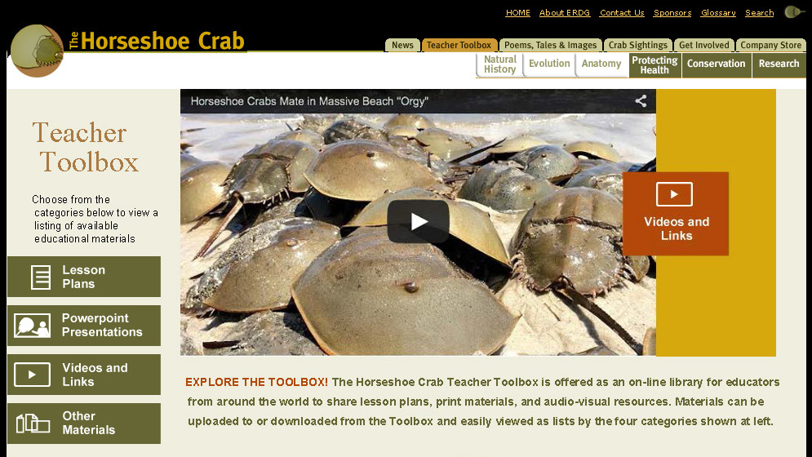
Horseshoe Crab Teacher Toolbox
a new on-line platform for global exchange of horseshoe crab outreach
& education resources
A contribution to the Education/Public Awareness session of:
The Third International Workshop on Science & Conservation
of Horseshoe Crabs, Sasebo City, Japan, June 17. 2015
By: Sharon Kreamer & Yiying Sheng (The Tatnall School) &
Gary Kreamer (Delaware Division of Fish & Wildlife)
Notes:
Just two weeks ago, an initiative long on our wish list for horseshoe crab education was realized in the launching of a Teacher Toolbox website for global sharing of horseshoe crab education and outreach resources.
In this presentation, we will overview how this website was developed, the way it works, and what it has to offer.

Slide 2
Toolbox background
grew out of 2011 HSC conference in Hong Kong
Action: Develop an international inventory of HSC education
and public awareness materials and approaches that
can be shared, adapted & applied across all countries
revisited at
IUCN HSC-SSG meeting in 2014
resulted in funding thru Molloy College
Toolbox designed & launched in 2015 by ERDG and now available for use at: www.horseshoecrab.org
Notes:
The concept for the Toolbox was a priority action item coming out of the Education & Public Awareness workshop at the 2011 International workshop in Hong Kong.
Due to lack of funding, it remained “just an idea”, until 2014, when a special planning meeting of the IUCN Horseshoe Crab Species Specialist Group hosted by Molloy College provided a forum for revisiting that goal.
Subsequently, funding for the project was provided by Molloy, and a course was set for Toolbox development and hosting through ERDG’s popular www.horseshoecrab.org website.

Slide 3
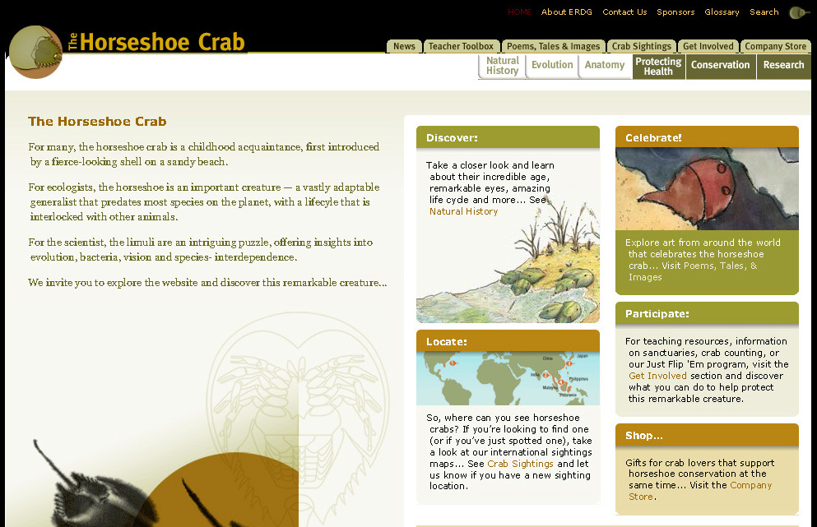
Accessing the Toolbox from the ERDG homepage
Or go there directly via: http://horseshoecrab.org/teacher-toolbox/
Notes:
This is where you’ll find the Toolbox on the ERDG home page.
The decision to host it there – rather then create a whole new site for it – was based on the premise that – as the most visited horseshoe crab website on the planet – there was already a large and growing audience on board for its use.

Slide 4
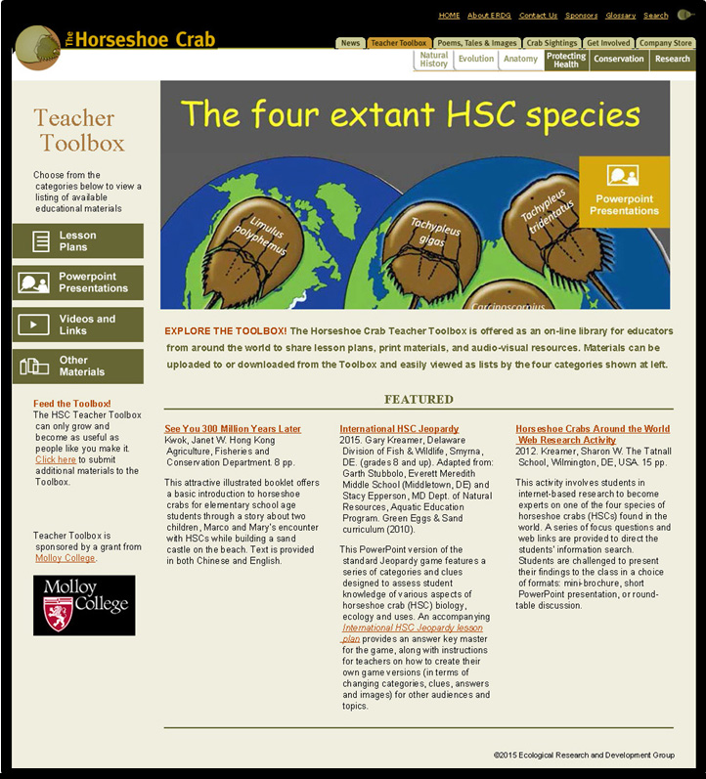
Designed for ease-of-use & navigation
features 4 categories of educational resources
seeded for start-up with items contributed by members of the IUCN HSC-SSG Education Working Group
clicking on a category pulls up easily viewable listings and descriptions of items available
Notes:
At first, we had the idea of making the Toolbox part of the already established HSC Research Data Base, but after due consideration, decided that content and searchability could easily get lost inside the mass of scientific articles found therein.
So we opted to give the Toolbox its own separate structure and functionality, and keep it as simple and educator-friendly as possible. To that end, we identified 4 essential categories of educational resources for inclusion. These categories are prominently featured on the left side of the Toolbox front page. They include: Lesson plans, PowerPoint presentations, Videos and links and Other materials.
For start-up, we seeded the Toolbox with a variety of materials contributed by members and friends of the IUCN horseshoe crab Education Working Group.

Slide 5
Lesson plans for the Horseshoe Crab Classroom
Clicking on any of the 4 categories takes you to a screen that provides listings and descriptions of the Toolbox resources available in that section
Notes:
We like the metaphor of a “Toolbox”, not only because it has a nice ring to it, but because it suggests a high level of utility & adaptability. A toolbox is something that can be filled with a variety of tools for taking on discrete tasks and completing prescribed projects. The contents of a toolbox can also be altered and restocked as specific project needs require.
That metaphor applies well to the lesson plan category of the Toolbox – a place where we hope educators from around the world will share their tried and true approaches to teaching about horseshoe crabs. We also hope educators will use, adapt and retool these shared approaches to meet new needs and audiences, and then resubmit plans back to the Toolbox for others to use.
One of the start-up items in the Toolbox is an activity we’ve developed that utilizes juvenile Limulus molt specimens to explore key details of horseshoe crab anatomy. We see this as especially conducive to adaptation to the 3 Asian species. For those wishing to get a hands-on flavor for what the molt anatomy lab has to offer, please come visit our booth at the public event tonight. We might even tempt those of you who don’t have access to Limulus molts with the prospect of a take-home souvenir for stopping by!

Slide 6
Viewing the listings
One can scroll down through the listings page by page.
New listings will be posted at the top as they are contributed.
Notice that some listings feature links to related resources.
Notes:
By selecting a category, a screen such as this one - showing the most recent items featured in that category - will appear. By scrolling down through the listings, one can view title, source, and a descriptive summary of what each of the items has to offer.
So, this is what the listing page for the Lesson plan section of the Toolbox looks like. At present there are only two pages of items, but we hope it will grow to include many more. It is set up so that, as new materials are added, they appear closer at the top of the page.
Note that we’ve also set this up so that listings can contain links to other associated materials in the Toolbox (point out examples of circled items on the summary side of the listings).

Slide 7
PowerPoint section
Seeded initially with a few items of general interest for HSC education
Slide shows can be submitted in pdf or ppt format (16 Mb limit)
Included here is an International HSC Jeopardy game adaptable for various venues
Notes:
Here’s a quick look at current listings in the PowerPoint section of the Toolbox.
One of the fun and highly adaptable items we’ve included is a horseshoe crab Jeopardy game (point to Jeopardy title on screenshot)
Note that clicking on the title for its Powerpoint listing takes you directly to the option of opening the game for playing, but if you’d like to learn how to adjust the game to insert your own clues, answers, categories and images for the game, you’ll need to click on the link at right to pull up the accompanying lesson plan for the activity.
Let’s take a very quick look at a special version of the game we created for this venue (click to next slide).

Slide 8
Notes:
The categories created for this game all have an international theme. Notice that the last category offers a “Name That Scientist” challenge.
If you’d like to try your hand at this Jeopardy game, please visit the Molloy College booth at the public event this evening.
At this point, I’m going to turn the presentation over to Gary to take you through more of the nuts and bolts of Toolbox operation …

Slide 9
Videos section
Can include video clips downloaded directly to the HSC Toolbox (pending file size limits) or ones accessible via links to Vimeo, YouTube, etc.
By providing brief, but salient descriptions for each video listed, we hope to make this a useful site for educators to easily locate and view HSC clips on various topics of focus and interest.
Notes:
The videos section of the Toolbox is a tad different in that most of the items here are in the form of links that take you outside the Toolbox, to places like YouTube and Vimeo, for actual video viewing.
The idea here is that if you have an HSC video on your website you’d like to share or if you know of one of educational value out there on the web, we encourage you to submit the url as a link, along with a brief description of what the video is about, so that others perusing the Toolbox for videos that address certain topics and needs, can easily find and access them. We see this as offering “one-stop shopping” for educators interested in showing HSC videos on certain topics, thus saving time spent searching for them all over the web.
On the next iteration of the Toolbox (pending funding availability), we would like to include a 1 to 5 star rating system and reviewer comments capability to this section.

Slide 10
Other Educational Materials section of Toolbox
This section of the Toolbox serves as a catch-all for various other kinds of HSC education resources worth sharing.
This may include children’s books, brochures, fact sheets, posters or assorted other print materials.
Notes:
Since not all educational materials fit the Video, PowerPoint or Lesson plan typology, we created a catch-all category for other kinds of horseshoe crab education and public awareness resources.
These could be in the form of children’s booklets, fact sheets, posters, brochures or various other print materials.

Slide 11
Downloading Toolbox materials is easy …
To access an item for download, simply click on the title line link.
pdfs (e.g. red circled item at left) open directly to the file.
Clicking on an item that was submitted in Word or ppt format (blue-circled item at left) results in a pop-up choice box for opening or saving file
Notes:
In America we say “piece of cake” to describe something that’s easy to do. We apply that metaphor here to describe the simple process provided for downloading Toolbox items.
Simply put, all one needs to do is click on the title of a listing to access it for downloading. Depending on the file format, there are two ways that this process works …
For items submitted as pdf’s, clicking on the title for that item in the listing (e.g. red circled item on screen) takes you directly to the item, which you can then save for your use.
For items submitted in word, ppt or other non-pdf file formats, clicking on the item title ( e.g. blue circled item on screen) will result in a Pop-up box that looks like this (click to next slide)

Slide 12
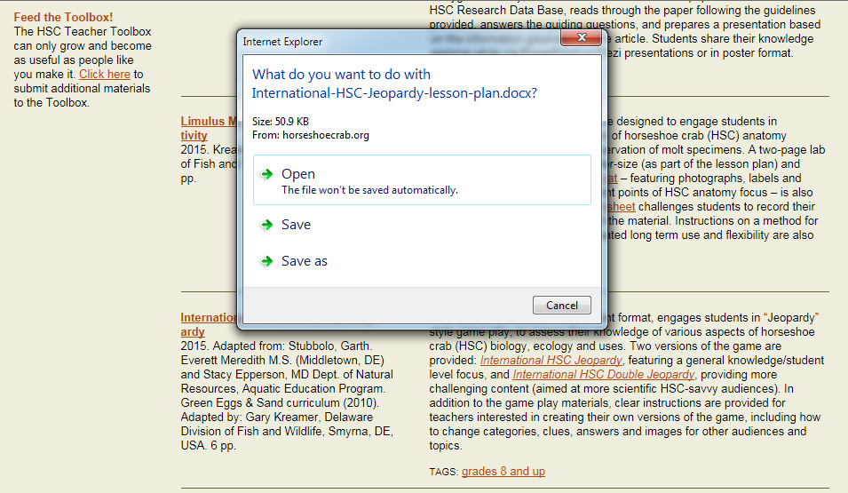
Sample download screen for Word or ppt file
Please note: Depending on file size, your system/server speed, and concurrent ERDG website traffic, downloads can be on the slow side.
Notes:
From there you can open or save the file for your use.
Please be patient in doing downloads - especially for larger PowerPoint files. Depending on things like file size & server speed, this could take anywhere from a few seconds to several minutes.
But it does work!

Slide 13
Searchability of the Toolbox
To keep it simple at this early, limited- items stage, we opted not to build in topic or keyword-based search capabilities.
As content grows, will explore avenues for adding this in.
Meantime, one can use ‘TAGS’ feature to pull up selected lists of items.
Notes:
Given the small volume of material in the Toolbox at start-up, we chose to not introduce complex topic or keyword search functions to it at this early stage. As the Toolbox content grows - and depending on the directions that growth takes – we will explore avenues for adding search engine capabilities to the Toolbox.
Meantime, the web designers built-in a useful “TAGS” feature that allows limited search by way of tags we place on all items submitted. At present these mainly take the form of age/grade level categories. Clicking on a TAG for a given listing pulls up all other items in the Toolbox for that TAG.
So, for example, if one clicked on the blue circled tag line in the screen above – for grade 7-12 tagged items, it would take you to a screen (click to next slide) …

Slide 14
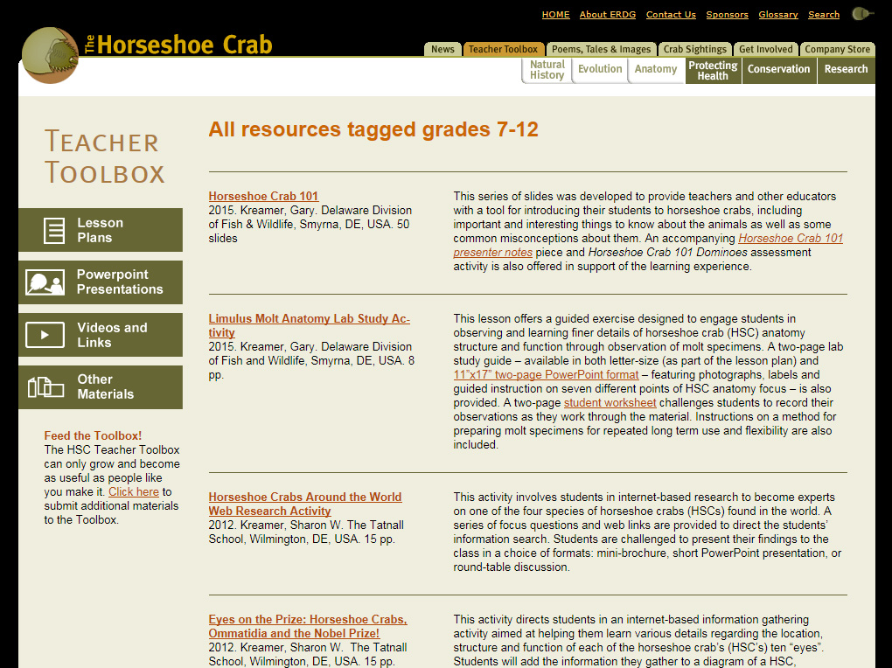
Results of a ‘TAG’ Search for grade 7-12 materials
Notes:
that looks like this - showing all grade 7-12 tagged items found in the Toolbox. As the Toolbox grows, we will expand the range of tags available for searching the Toolbox accordingly.

Slide 15
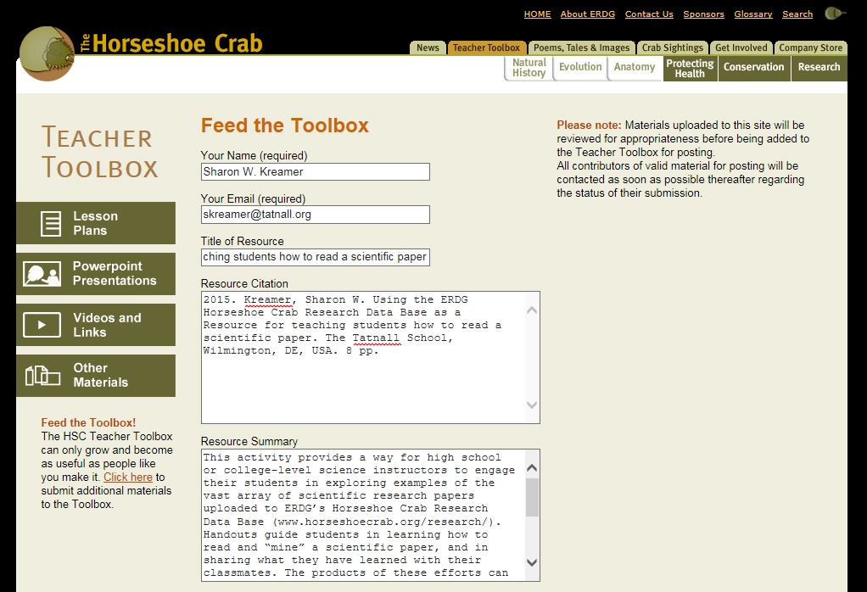
Feeding the Toolbox … the key to its growth!
Hitting “Click here” opens up a simple form designed to capture key elements of the submission citation.
A summary box provides a capsule description of what the listing offers to provide preview info for Toolbox browsers.
Notes:
And that provides an apt segue to the last, but most vital, piece of the Toolbox structure we want to show you. As with culturing young HSCs, we need to feed the Toolbox well to see it grow.
Although, we didn’t use the ‘piece of cake’ metaphor here, we probably could have, because the process of contributing materials to the Toolbox is pretty simple.
Every page of the Toolbox features a ‘Feed the Toolbox’ section in the lower left area. Hitting “Click here” from that place opens up a forms page that looks like the screenshot here.
In addition to the essential contributor, title and citation form fields, a key part is the “Resource Summary” box, since this describes what the resource has to offer as it will appear in the listing.

Slide 16
Completing the ‘Feed the Toolbox’ process …
The bottom part of the form captures
info on the category of materials
submitted, ages/grade levels targeted and the language (s) communicated.
All fields must be filled in from the scroll down form, and the file uploaded to complete submission to the Toolbox.
Hitting ‘Send’ automatically emails the file and form to Gary & Glenn for review and posting in the Toolbox.
Contributors will be notified by email once a file has been added to the Toolbox or if problems should arise with a submission.
Notes:
Scrolling further down the ‘Feed the Toolbox’ form, one finds simple check boxes for indicating the category of resource contributed, the grade/age level it targets and the language or languages that it’s submitted in.
All fields must be completed and either file uploaded, or in the case of a video, a url for a web link provided to complete the submission. Once that is done, hitting send automatically emails the form and file to Glenn and Gary for review and publishing to the Toolbox.
Those submitting items to the Toolbox will be emailed as soon as possible thereafter.
A key note on all this: Glenn & Gary will be screening all entries for publishing - but with us not being fluent in languages other than English - we will definitely need help with translation to other languages, so if any of you are willing to help us with that, please let us know.

Slide 17
A lesson plan of particular interest to this audience
This lesson plan targets advanced high school to college level students.
As such, it provides a two-fold focus:
1) guiding students
on how to read
and interpret a
scientific paper
2) exploring ERDG’s
comprehensive
HSC Research
data base as a
source for such
Notes:
Before we close, we want to share a special Toolbox item developed by Sharon that many of you in the University or High School level instructor realm will find useful. (turn presentation over to Sharon)
As a high school science teacher, one of my goals is to prepare students for college. Part of that preparation includes exposing student to current research found in scientific journals.
Reading a scientific paper & making sense of the contents can be one of the more challenging things a high school or college student faces. It can be a daunting task to wade through a paper and pull out the key information, especially when a student is not familiar with the terminology or experimental procedures involved.
This lesson plan was developed to address that challenge, while at the same time enabling students to learn more about horseshoe crabs via reading papers posted on ERDG’s extensive HSC Research Data Base.

Slide 18
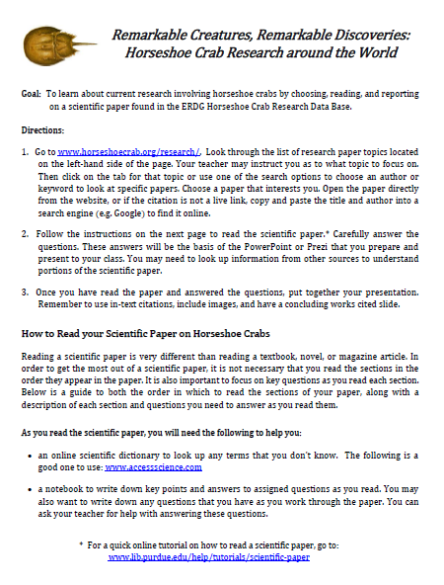
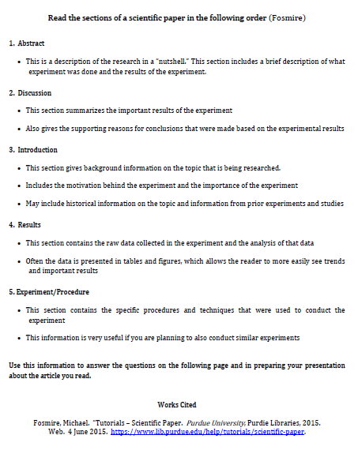
Sample pages from ‘reading a scientific paper’ lesson plan
Notes:
When you click on the title for this, the lesson plan and activity sheets will open up. You can then read through the introduction and goals, as well as the student handouts that contain the guided questions and instructions for creating a visual presentation of the main points of the paper. Students can then share this presentation with their class.
This activity allows for both individual and interactive group learning, and is a great way to equip students to read scientific papers and share their newly acquired knowledge with classmates in an engaging and interesting way.
But rather than have me, the teacher, tell you the benefits, we think it is much more interesting to hear from a student and see an actual presentation constructed via this activity.
My student, Yiying Sheng, who just graduated high school earlier this month, and who is very passionate about HSCs, will now share what she has learned through doing this activity.

Slide 19
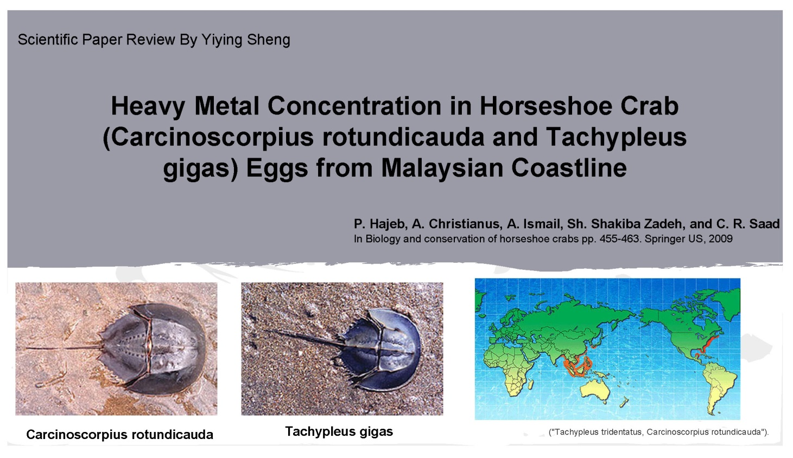
A quick glimpse at a sample student project from use of this lesson plan
Contributed by:
Yiying Sheng
(from China)
recent graduate of the Tatnall School, Wilmington, DE
Notes:
Yiying to say a little bit about how she became interested in HSCs.
To do this student project, I went online and browsed the ERDG Horseshoe Crab Research Data Base, using the search options to look at different topics and titles of scientific papers.
I chose this scientific paper because I am interested in both the impact of environmental changes on the horseshoe crab and on the economic impact of pollution.
Then I used the guided questions in the assignment as I read the paper & as I constructed a PowerPoint presentation to be shared with my class.
This slide and the following two slides are from my presentation.
This first slide contains: the title page, the main question addressed in the research, and the most important background information that my classmates would need for understanding the research.

Slide 20
Guided reading of the article using focus questions from the lesson plan give students the tools needed to get the most out of the paper
Notes:
The assignment instructs the student on what order to read the sections of the paper & gives guiding questions to help the student get key information from the paper and understand the research.
It allowed me to easily learn from the paper & remember what I read. If I just read the paper straight thru, I wouldn’t remember so well.
But with the guide, the questions, and the action of creating the PowerPoint, I really got a lot of understanding out of reading the paper and remembered what I learned about the research.
Now I will be able to share this information confidently with my classmates.
These two slides give a general overview of the Experimental Procedure and the Important Data given in the scientific paper.

Slide 21
Preparing and presenting the PowerPoint deepens student’s knowledge about the research while allowing classmates to learn from each other.
Works Cited
Notes:
The Discussion and Conclusion slide shows the most significant outcomes of the study. The Works Cited slide includes the actual scientific paper and the other sources I used to understand the paper, as well as citations for the images used in creating the PowerPoint.
Now I can share this presentation with my class and they can easily learn about the key points of the research from me. In a classroom, if all the students do this assignment and present their PowerPoints to the class, the whole class will learn about many different research studies from each other. This will allow all of us to become more knowledgeable about current research involving horseshoe crabs.

Slide 22
Some closing thoughts on the HSC Toolbox
provides convenient platform for sharing HSC-ed resources and approaches around the world.
saves time & money spent “reinventing the wheel” in sharing tried-and-true approaches.
promotes adaptation of materials to different needs and audiences
Will ultimately only be as useful as people like us make it! Please spread the word & promote its use in your domain!
Notes:
OK, hopefully we’ve accomplished our mission of introducing you to the new Horseshoe Crab Teacher Toolbox and what it has to offer.
We feel strongly that this offers a great vehicle for sharing our collective resources for promoting HSC awareness, education and conservation to teachers, school children and other audiences around the world.
As with so many things we talk about this week in Japan, the measure of Toolbox impacts will ultimately be defined and determined by the people in this room, and the threads of connectivity that weave out from us, as we return to our respective domains and our work for horseshoe crabs.
And so we invite you to visit the Toolbox at your next opportunity … add it to your list of favorite web sites to visit … promote what it has to offer other educators you know in your part of the world … and revisit it often to watch it grow. We thank you for giving it your support!

Slide 23
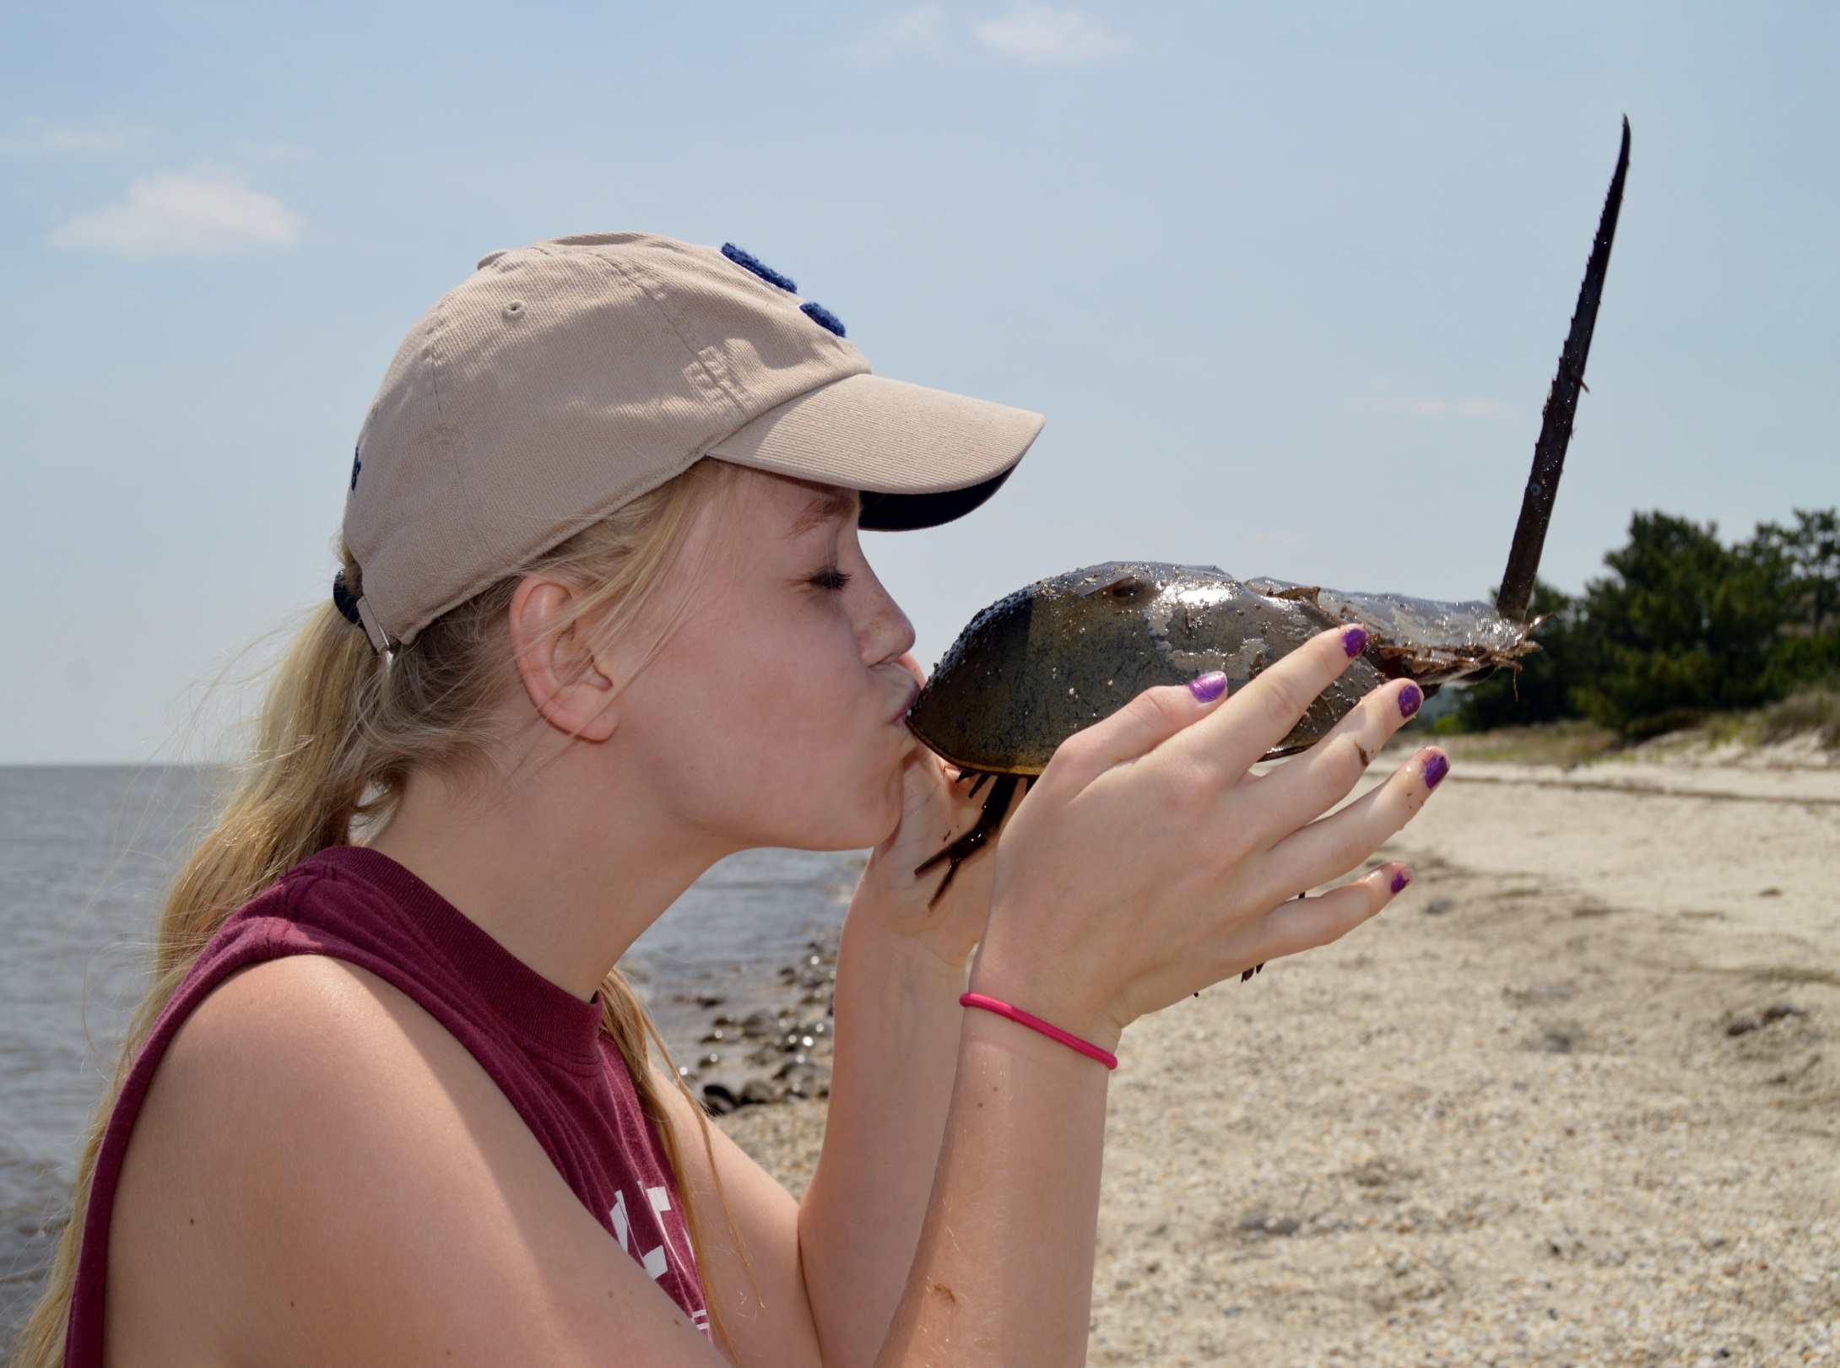
Kabutogani love … pass it on!
Photo courtesy of Jennifer Schwartz

